Slide 1
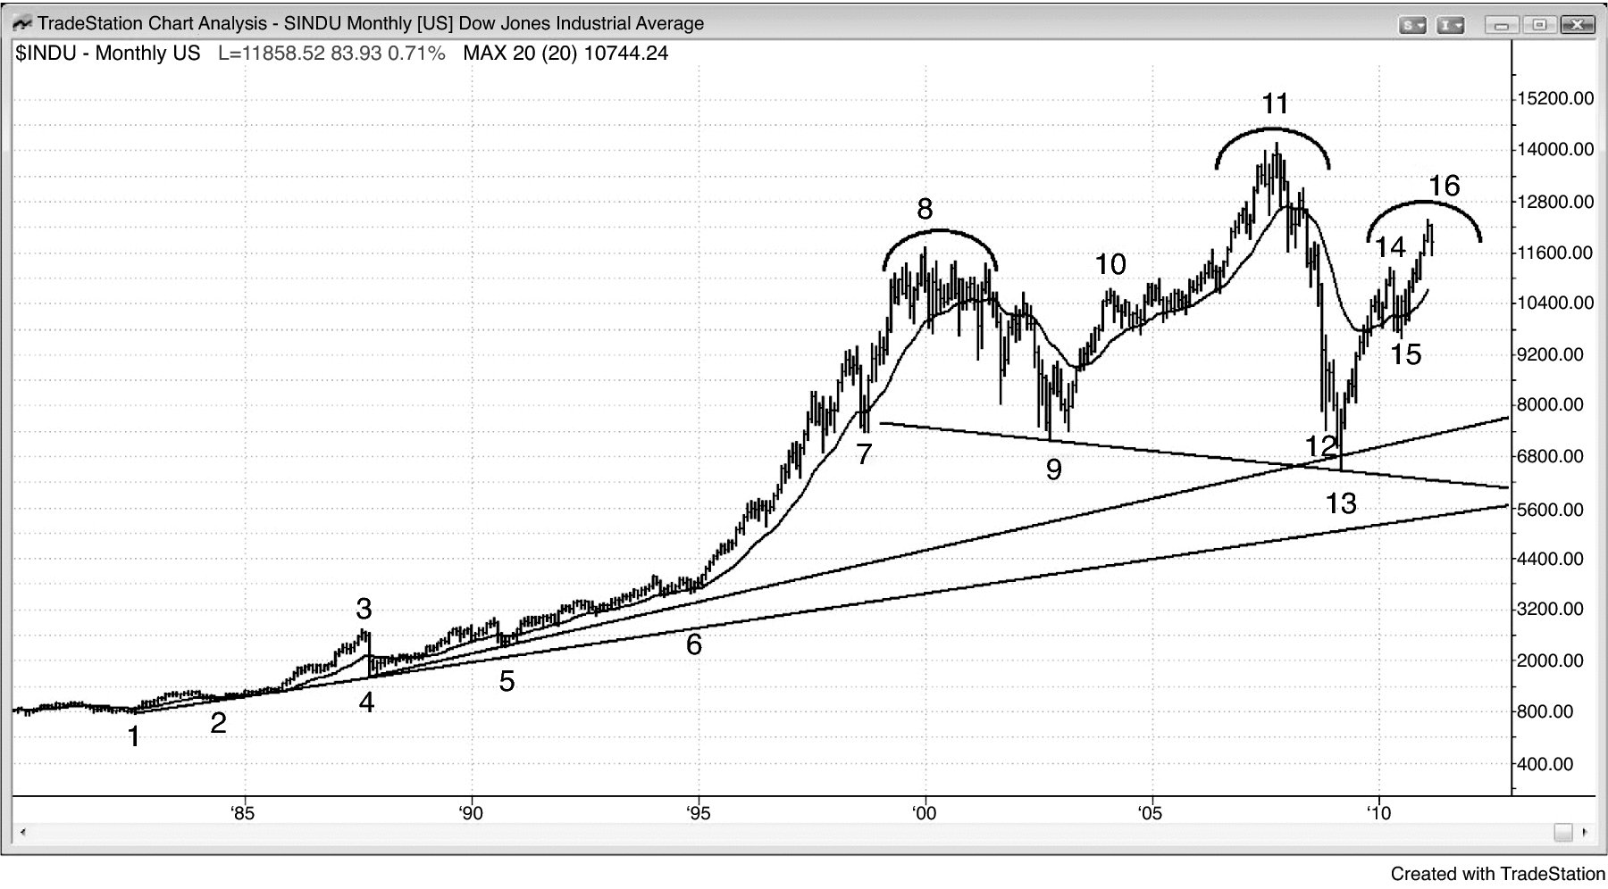
FIGURE PI.1 Dow Jones Industrials Monthly Chart

Slide 2
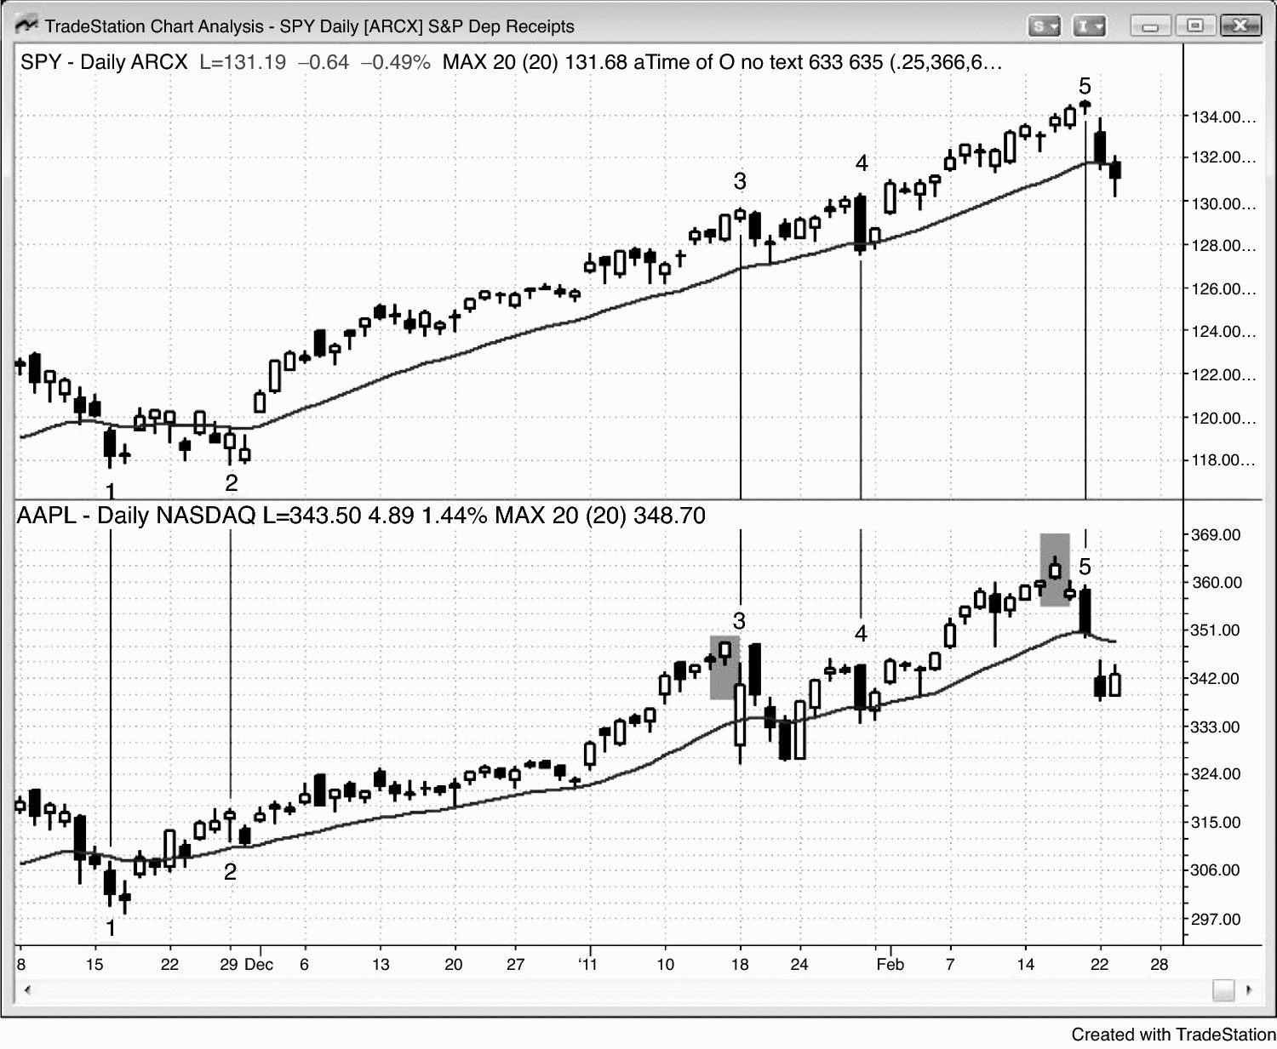
FIGURE PI.2 Market Leaders Often Lead the S&P

Slide 3
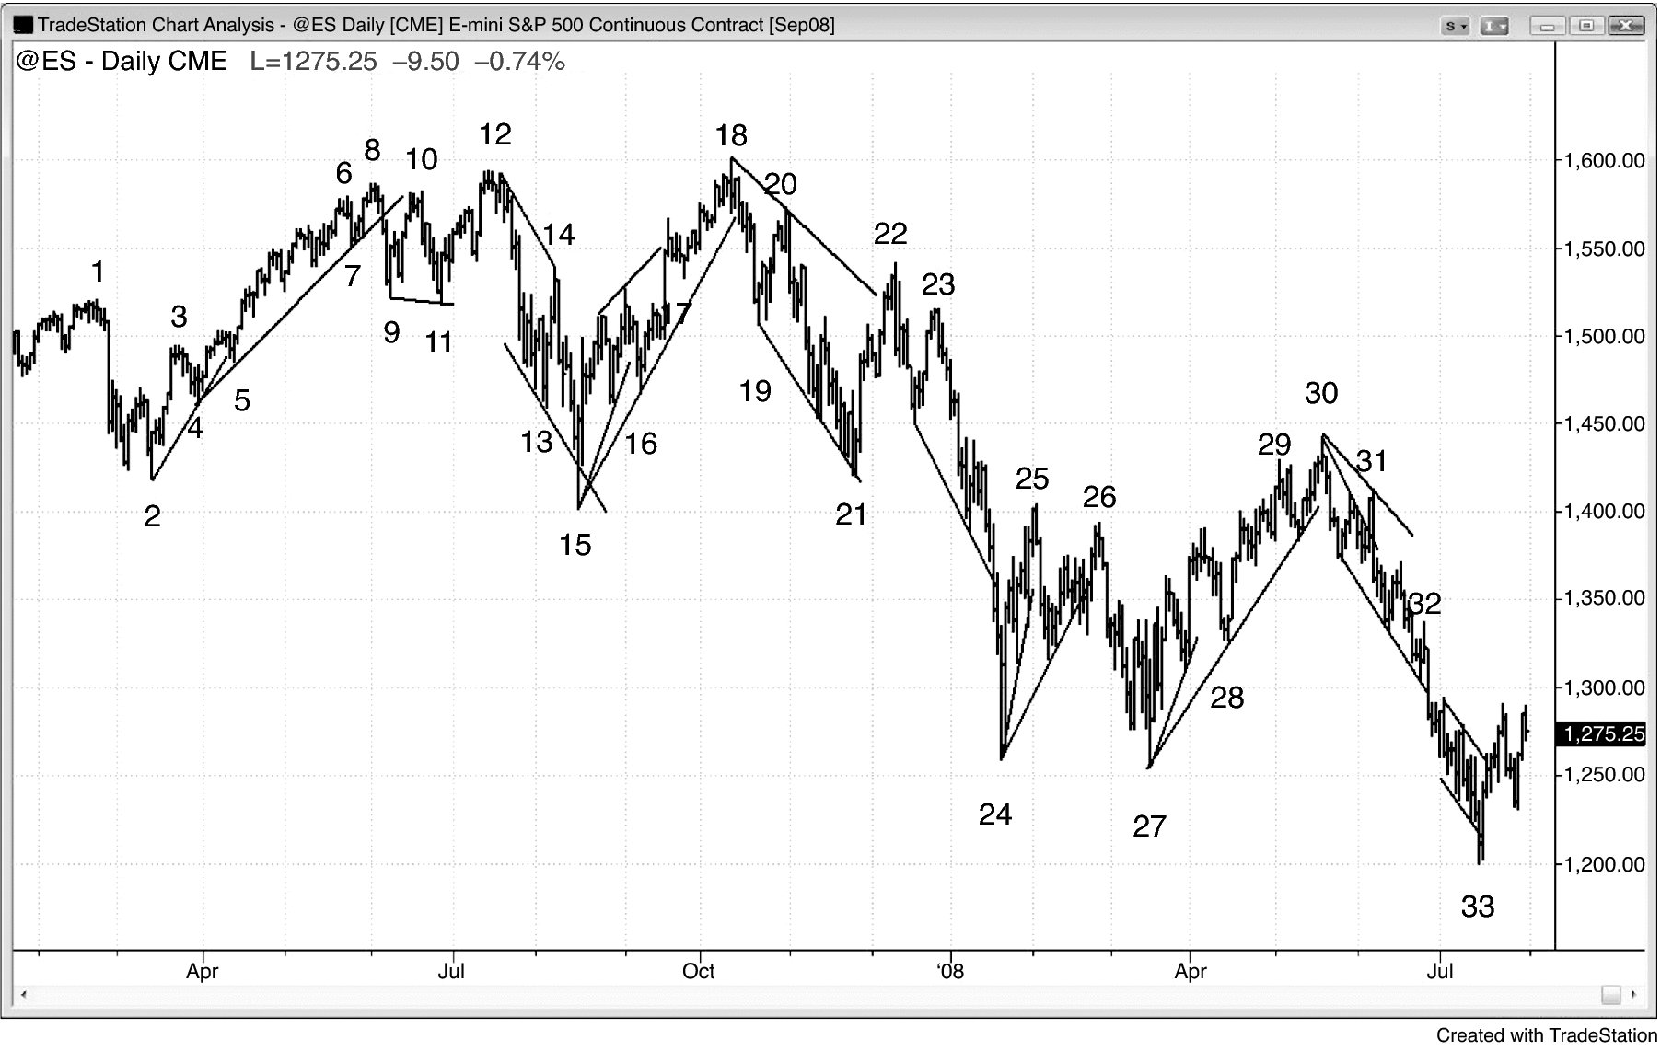
FIGURE PI.3 Reversals in the Daily Emini

Slide 4
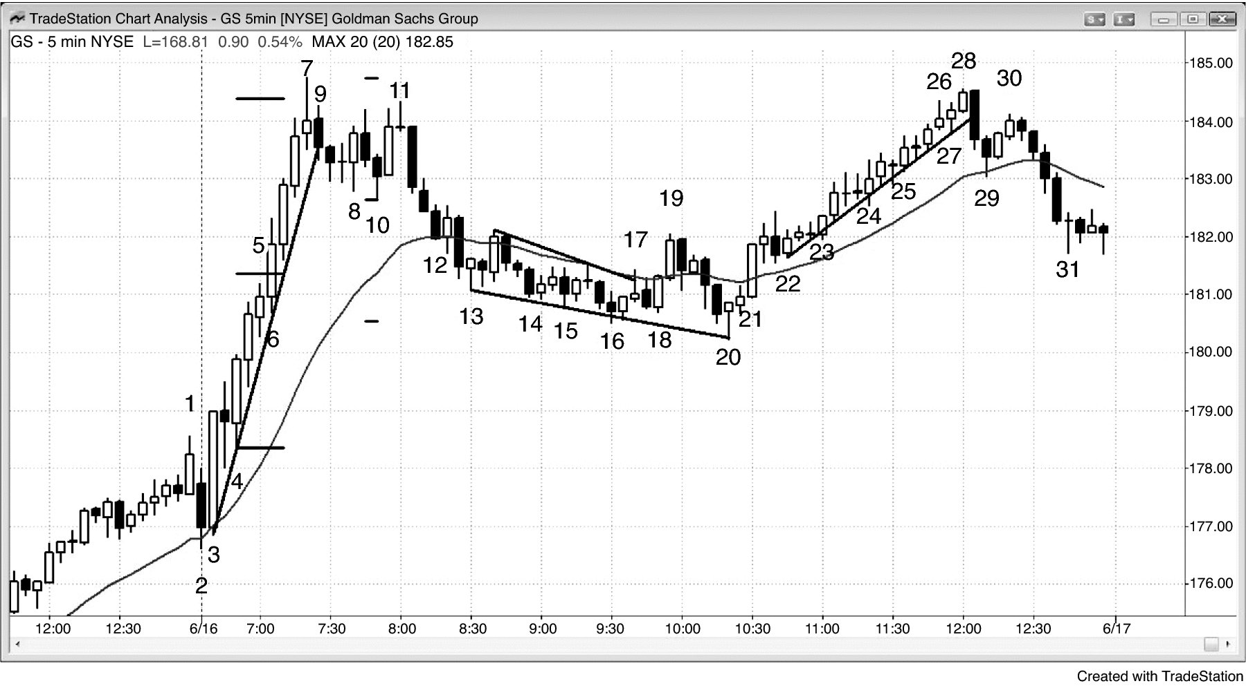
FIGURE PI.4 Consecutive Buy Climaxes and Deep Corrections

Slide 5
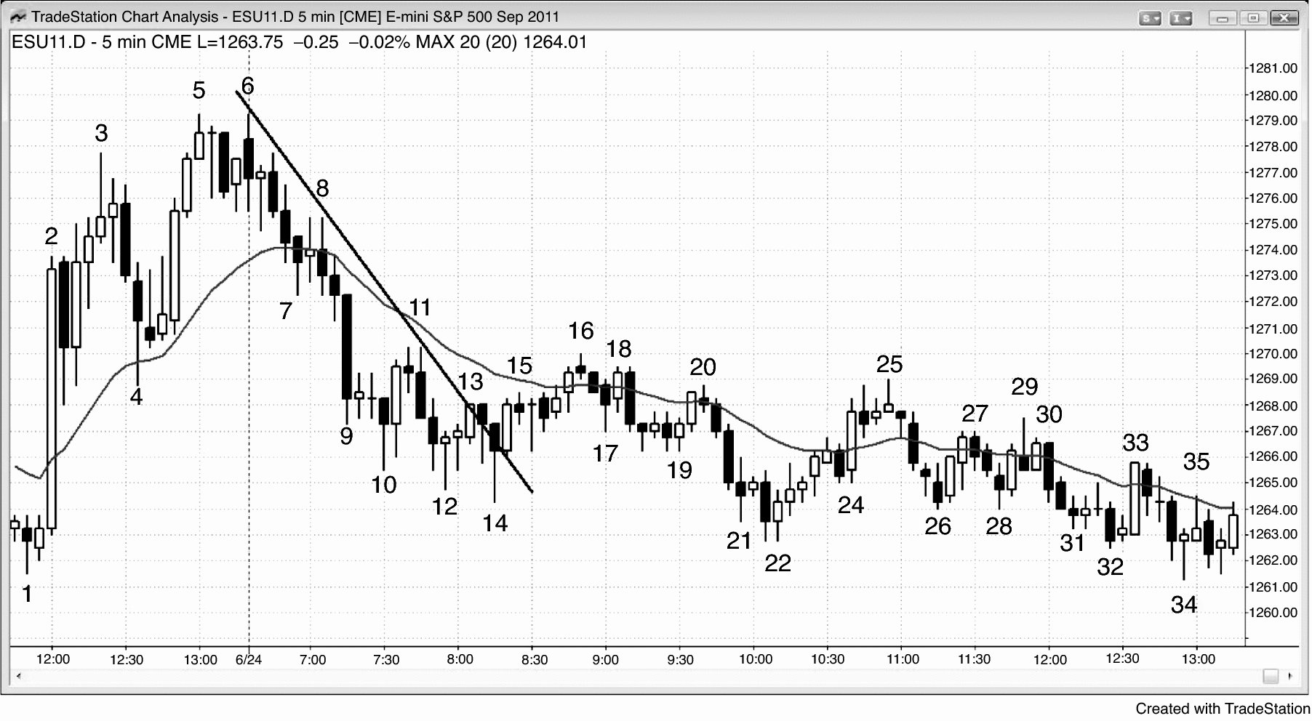
FIGURE PI.5 Uncertainty as a Major Trend Reversal Sets Up

